Slide 1

cinda
smart evaluations, better connections.

Slide 2
How do I get…
Q-hack 2025, mannheim
Notes:
as a company, how do I get…

Slide 3
How do I get…
…the right consultants?
🦸
Q-hack 2025, mannheim

Slide 4
How do I get…
…the right consultants?
🦸
…at the right time?
⏰
Q-hack 2025, mannheim

Slide 5
How do I get…
…the right consultants?
🦸
…at the right time?
⏰
…for the right project??
💼🗃️
Q-hack 2025, mannheim

Slide 6
How do I get…
⁉️
…the right consultants?
🦸
…at the right time?
⏰
…for the right project??
💼🗃️
Q-hack 2025, mannheim

Slide 7
Problem
Q-hack 2025, mannheim

Slide 8

Problem
Q-hack 2025, mannheim

Slide 9
Problem
loss of sales
Q-hack 2025, mannheim

Slide 10
Problem
loss of sales
customer dissatisfaction
Q-hack 2025, mannheim

Slide 11
Problem
loss of sales
customer dissatisfaction
employee dissatisfaction
Q-hack 2025, mannheim

Slide 12
Problem
⏱️
loss of sales
customer dissatisfaction
employee dissatisfaction
Q-hack 2025, mannheim
Notes:
late decision-making ⏱️

Slide 13
Problem
⏱️
loss of sales
customer dissatisfaction
😵
employee dissatisfaction
Q-hack 2025, mannheim
Notes:
“good enough” profiles kill momentum 😵

Slide 14
Problem
⏱️
loss of sales
customer dissatisfaction
😶‍🌫️
😵
employee dissatisfaction
Q-hack 2025, mannheim
Notes:
underutilized talent 😶‍🌫️

Slide 15
Problem
⏱️
loss of sales
🗣️
customer dissatisfaction
😶‍🌫️
😵
employee dissatisfaction
Q-hack 2025, mannheim
Notes:
poor communication fit 🗣️

Slide 16
Problem
⏱️
loss of sales
🗣️
customer dissatisfaction
😶‍🌫️
😵
employee dissatisfaction
🤔
Q-hack 2025, mannheim
Notes:
Subjectivity in decision making 🤔

Slide 17
Problem
⏱️
loss of sales
🗣️
customer dissatisfaction
😶‍🌫️
😵
employee dissatisfaction
🤔
🧠
Q-hack 2025, mannheim
Notes:
lack of domain knowledge 🧠

Slide 18
Problem
⏱️
loss of sales
🗣️
customer dissatisfaction
😶‍🌫️
😵
employee dissatisfaction
👀
🤔
🧠
Q-hack 2025, mannheim
Notes:
ignoring relevant information 👀
Like…

Slide 19


Problem
⏱️
loss of sales
🗣️
customer dissatisfaction
😶‍🌫️
😵
employee dissatisfaction
👀
🤔
soft skills – team fit – values – project history – self-organization vs. need for leadership – timezone compatibility – performance in different project phases– sustainability concerns – knowledge of customers, tools & processes – scheduling of the consultants – willingness to learn – fast-fit potential – view of the bigger picture vs. focus – focus on strategy vs. operations – relevance as a stakeholder
🧠
Q-hack 2025, mannheim
Notes:
…soft skills
Team fit
Fast-fit potential
And many more

Slide 20
Problem
Usp:
- human centered approach
Berater können sich weiterentwickeln
Steps in die präsi reinnehmen
Q-hack 2025, mannheim

Slide 21
Our solution
Usp:
- human centered approach
Berater können sich weiterentwickeln
Over & understaffing
Q-hack 2025, mannheim

Slide 22
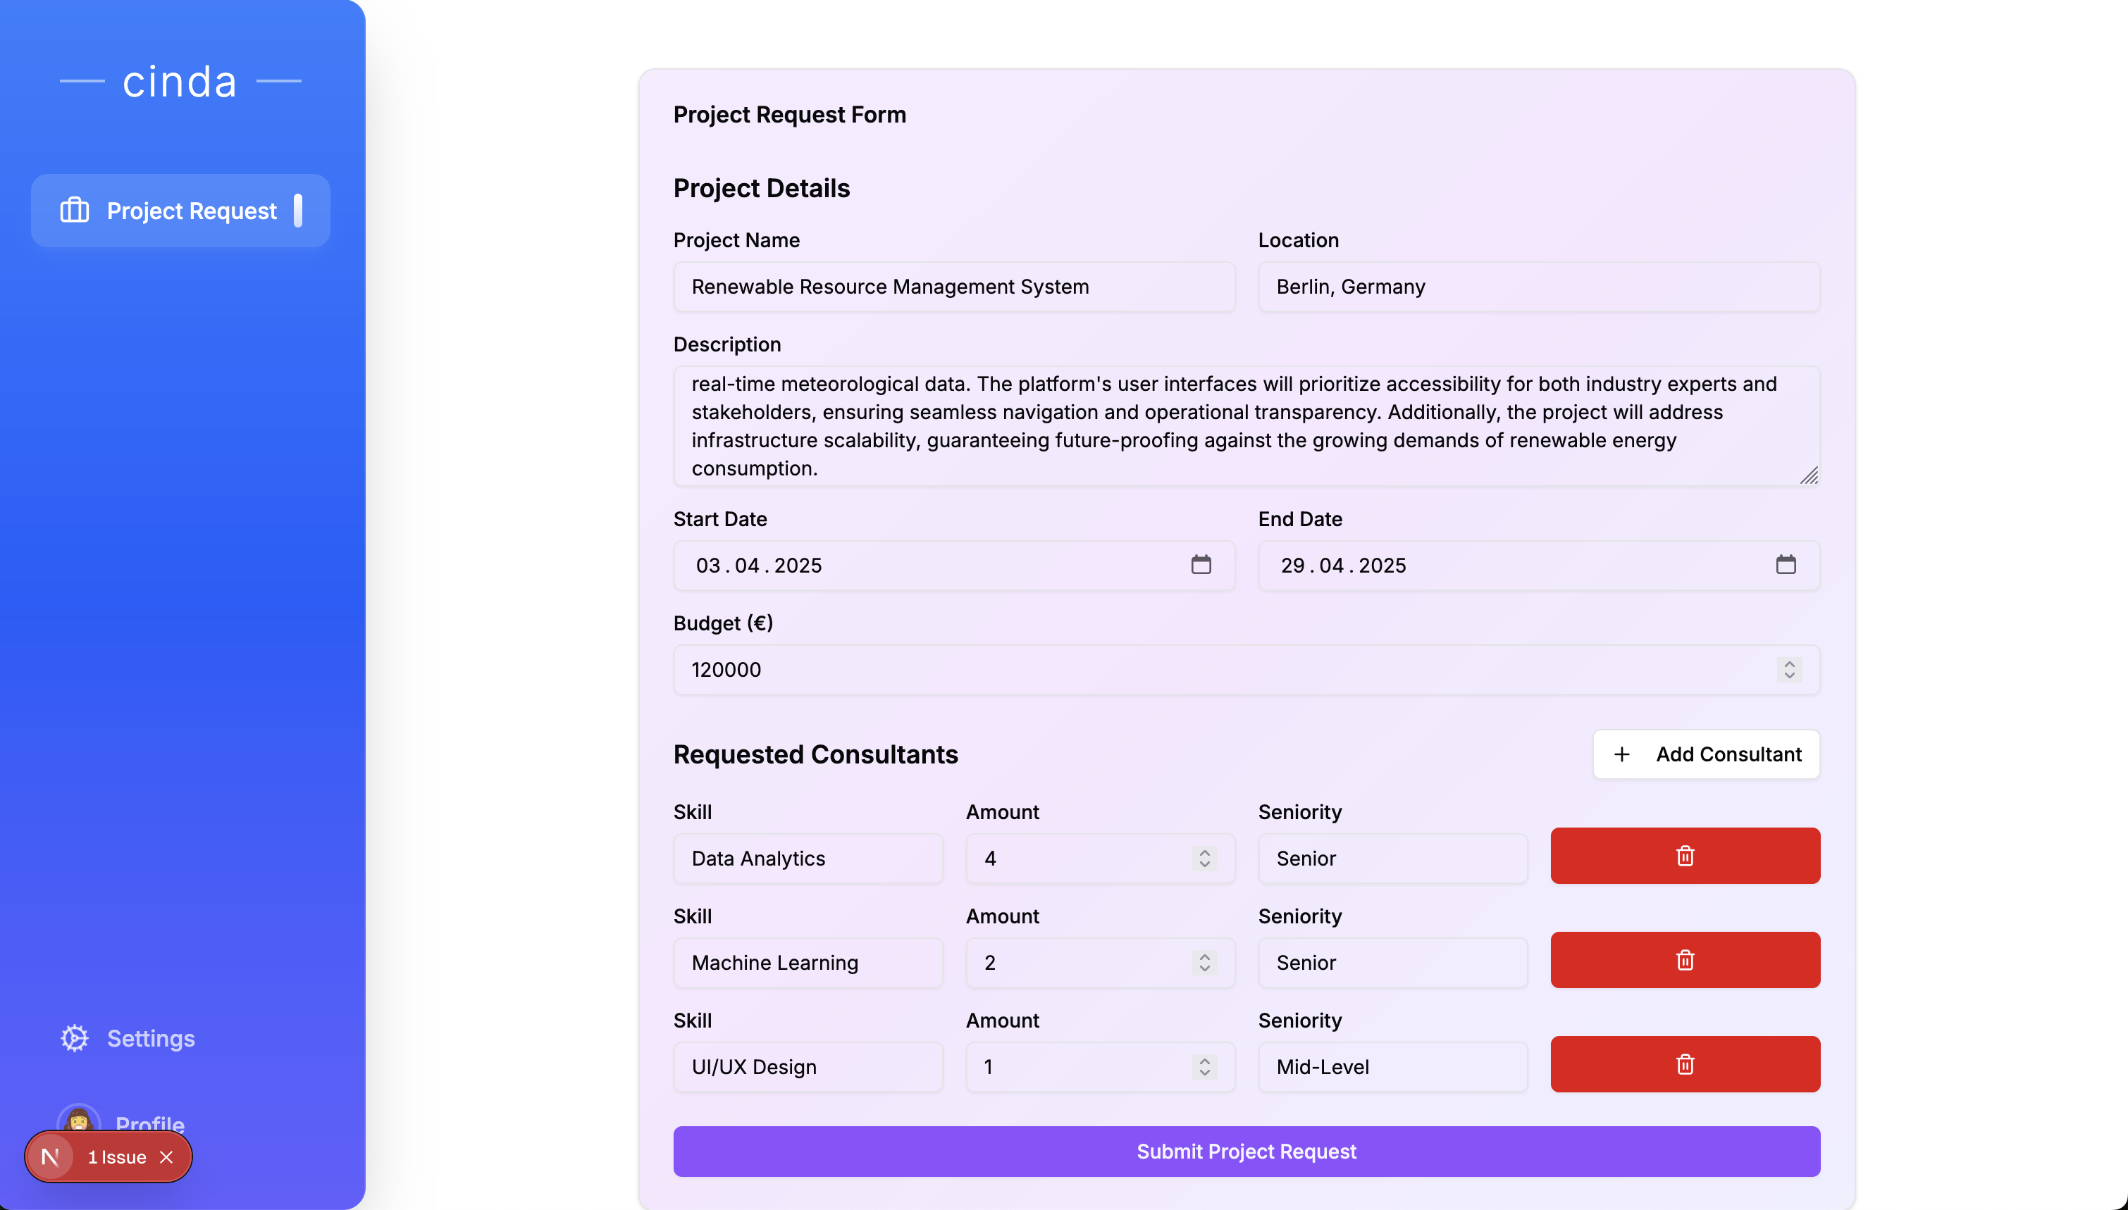

Slide 23
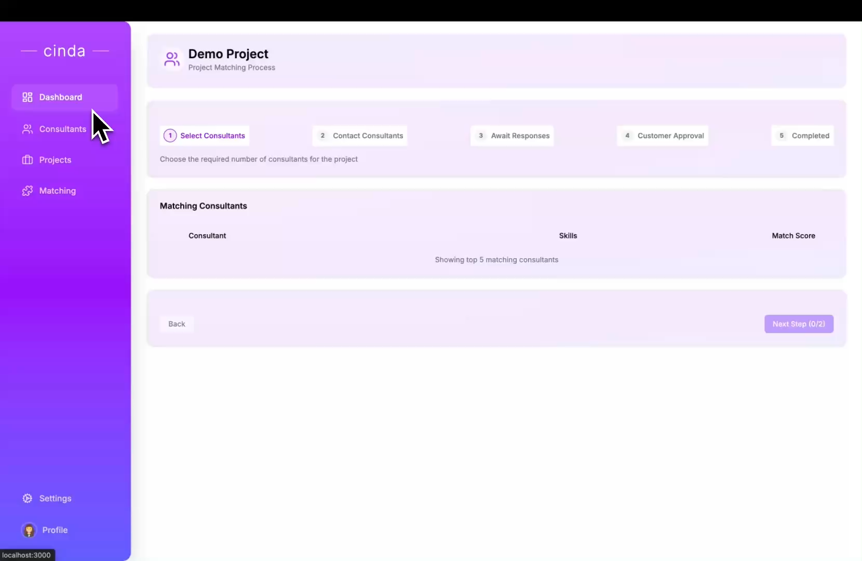
Q-hack 2025, mannheim

Slide 24
Our solution
🙋
Q-hack 2025, mannheim
Notes:
Human-centered approach

Slide 25
Our solution
skill gap analysis
🙋
Q-hack 2025, mannheim
Notes:
We analyse skills of the consultants
Hereby we can make use of fast-fit potential
and help consultants to develop their skills further

Slide 26
Our solution
skill gap analysis
simulation
🙋
Q-hack 2025, mannheim
Notes:
We simulate the consulting of each & every consultant
for profit optimization
and to meet the goals of the organization

Slide 27
Our solution
skill gap analysis
simulation
🙋
prevent over- and understaffing
Q-hack 2025, mannheim
Notes:
By adding availability tracking,
we additionally prevent overstaffing and understaffing

Slide 28
Our solution – DEMO
VIDEOOOOOOOOO
Q-hack 2025, mannheim

Slide 29
Monetization
one-time setup fee – 5.000 euro
annual license fee – 200 euro per consultant
optional support package – 10% of license fee
Q-hack 2025, mannheim

Slide 30
*Zahlen*
Global IT-Consulting Sector Volume 72bn€
Expected growth until 2029 4,18%
Q-hack 2025, mannheim

Slide 31
Demo
Q-hack 2025, mannheim

Slide 32
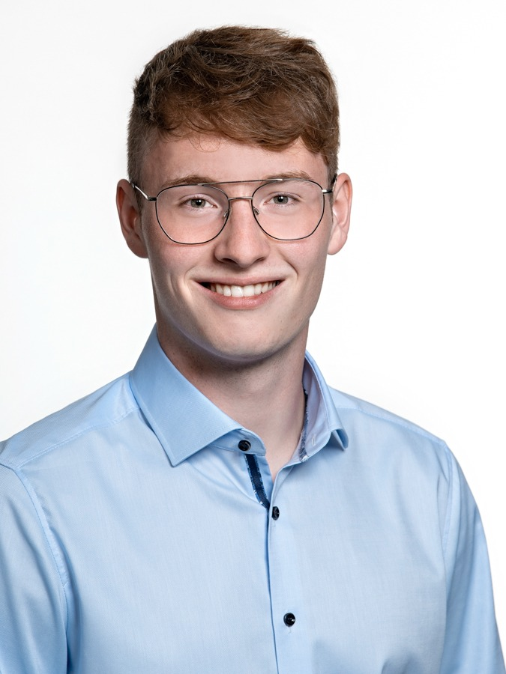
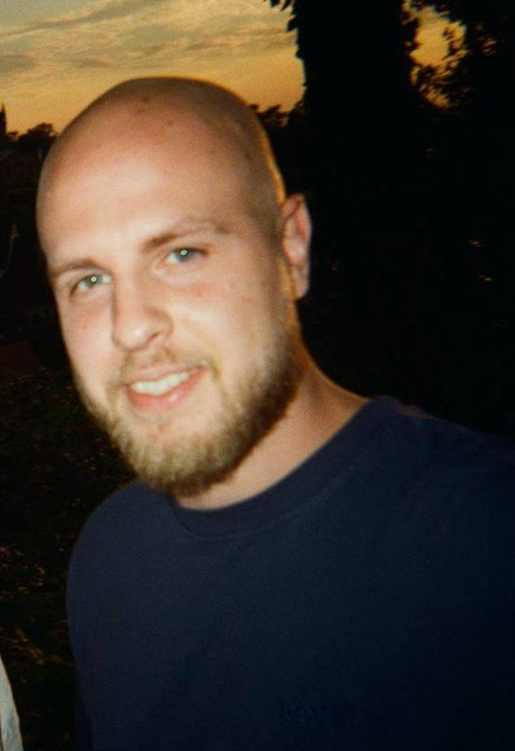


Our team
Q-hack 2025, mannheim

